Slide 1

Welcome to Acorn Class
2025-26

Slide 2
What we will be covering…
Staff
Things to remember
What we will be learning
Forest School
How to contact us
Questions

Slide 3
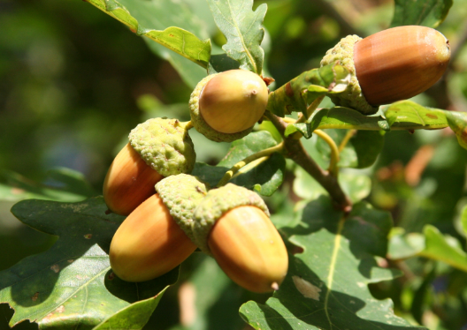
Staff in Acorn
Class Teacher – Sam Milne
Teaching Assistants – Sophie Baldry-Reynolds, Daphne Blakey, Kirsty Wiles
Executive Head – Ian Bartle
Head of School – Anna Hedges
SENDCo – Becky Wood
Senior Teacher – Amy Champkin

Slide 4
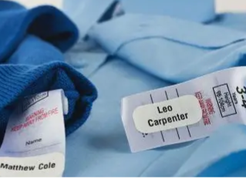
Things to remember
Drinks bottle
Packed lunch
Spare clothes
Reading book and record
Coat (we will be outside whenever possible!)
An afternoon snack
Please name everything!
The children do not need to bring in pencil cases from home as we provide the children with everything they need.

Slide 5
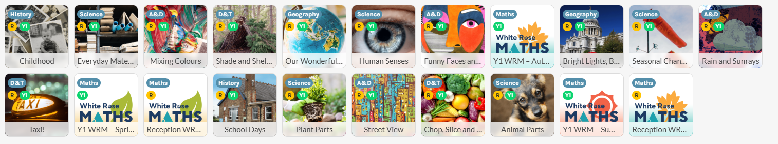
Long term plan

Slide 6


Autumn Term Topics
Childhood
This project teaches children about everyday life and families today, including comparisons with childhood in the 1950s, using artefacts and a range of different sources.
Bright Lights, Big City
This project teaches children about the physical and human characteristics of the United Kingdom, including a detailed exploration of the characteristics and features of the capital city, London.

Slide 7

Phonics
We use Unlocking Letters and Sounds (ULS) for phonics.
Children have daily phonics sessions.
In June, children in Year 1 will sit the Phonics Screening Check which involves them reading 40 real and alien words.
What can you do at home to support your child?
Please listen to your child read at least three times a week and write in their reading record when you do.
Share stories with them.
Talk about what has happened in the story / what might happen.

Slide 8
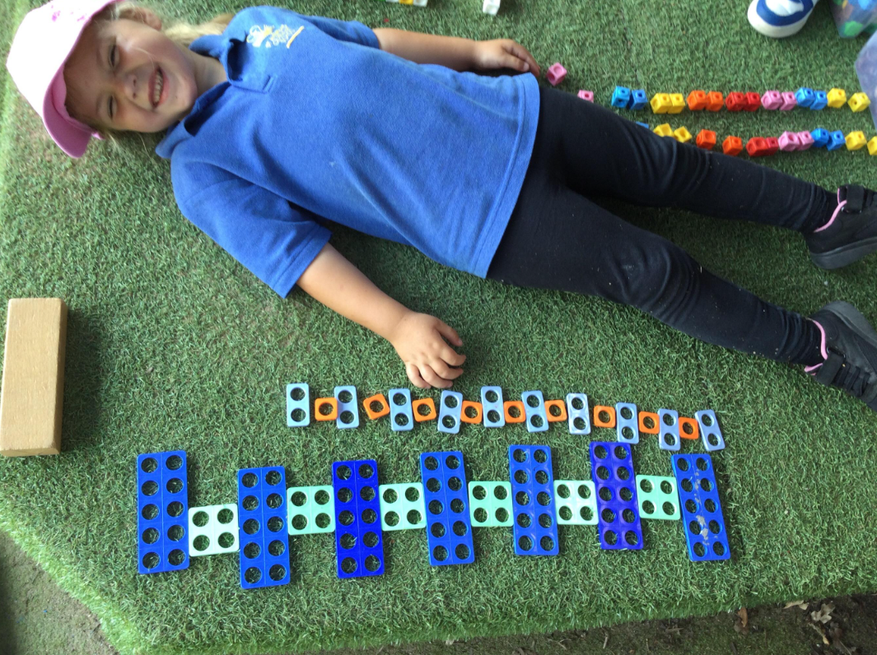
English and Maths
English
- We follow ‘The Write Stuff’ for English, this supports the children with building sentences and thinking about vocabulary they can use.
- Each unit is based on a book and focuses on different plot points during the story.
Maths
We follow White Rose Maths.
Big part of understanding maths in early years is using practical resources so try to make lessons as practical as possible.
Year 1 children will be given logins for using Doodle Maths.

Slide 9
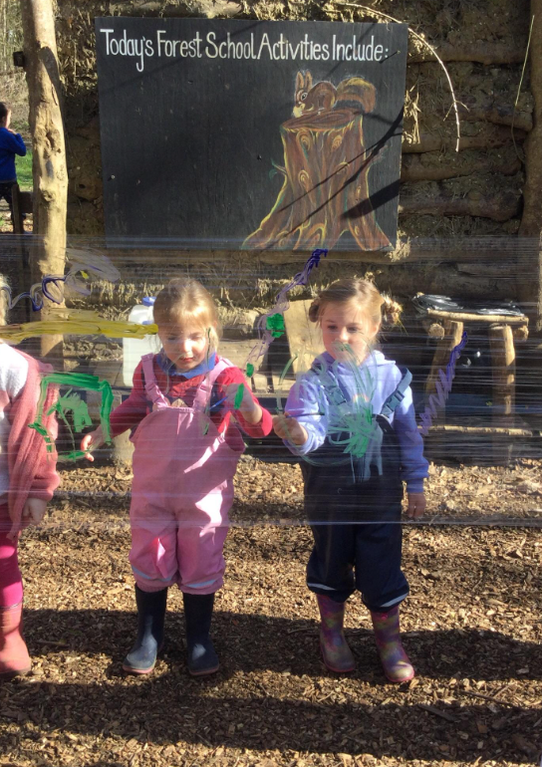
Forest School
Offers children hands-on learning experiences in nature, encouraging exploration, creativity, and skill development in an outdoor setting. Your child will go once a month, on a Monday, for a full day.
Clothing Requirements:
1. Old Home Clothes
2. Wellington Boots
3. Waterproofs
4. Change of Clothes
5. Long Sleeves and Trousers
6. Suncream for warmer days

Slide 10
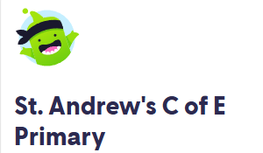
How to contact us
ClassDojo
Beginning / end of day
Email Hannah in the office to ask for an appointment

Slide 11

Questions?

