Slide 1
Welcome to Otter Class – Reception and Year 1

Slide 2
In this meeting we are going to go through -
Welcome to Otter Class
Reading
Time table- Forest School
Phonics
New PE T-shirts (don’t panic)
Dojo
And of course time to ask questions!

Slide 3
Otter Class has an increase in expectation!
Children to begin to come into the class on their own. (No rush, we will decide when the children are ready together)
Healthy snack provided. Otter class eat snack in the classroom
Greater responsibility – classroom jobs. These will increase for Reception over the year as they become more confident
PE this half term on Monday.- T-shirts I believe will be going to Navy Blue. Phased over the year so please don’t rush to get new ones
Forest school- first year we get to go as a whole class!

Slide 4

This year is all about having an absolute love for reading!
We will do whole class reading every day.
Encouraging children to read wherever they are. Signs, shopping, walking home any opportunity for reading.
Phonics follows Read, Write Inc scheme.
I would like to read a chapter book to the children, last year was James and the Giant Peach… this years to be decided.

Slide 5

Reading at home.
Please read with your child as often as you can at home.
Please sign when they have completed their book.
We will change their book on a Tuesday- this allows for a week to read at home. At this stage repetition is key! We will read different books in school with the children and we have a school reader in on a Thursday. Please ask them questions about the book and check their understanding.
If they are tried take turns to read. Even 5 minutes is better than none! It is also great to be read to, so if you can add it in as part of your night time routine.

Slide 6

Maths in Otter Class
Recognising Maths in the environment
Recognising numbers that are familiar- Birthdays, Door numbers.
Try to learn maths in lots of different ways eg, games, apps, chanting, songs. Counting stairs, forwards and backwards.
Year 1’s are joining Hedgehog class for maths and will continue their activities in Otter Class.

Slide 7
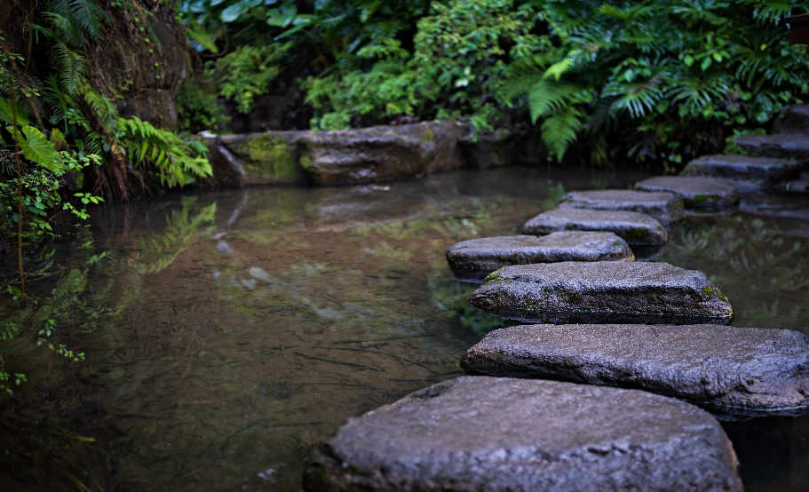
Forest School
Every 4 weeks first one 5th October. We follow Hedgehog class on the timetable
Never been as a class before
What does this mean for Welly Wednesday?
MUST BE PREPARED FOR THE DAY!
Fiona will we be walking with us on the first visit. If you are available, please can you walk with us. We can’t do it without you

Slide 8
Read Write Inc
The phonics scheme we follow at St Andrews (It’s new to me too)
Children will be learning sounds in a set order suggested by the scheme including a variety of ‘Red Words’ and special friends.
It is tricky, do please ask if you need any help if you are practicing at home.
Phonics lessons will be taught in the sequence and interventions will happen for children who need a little extra support (This is completely normal if they don’t take it all on in one go. They are learning so much!)

Slide 9

Class Dojo
Its free, please don’t pay, there is an option to but Please skip.
No Dojo points
Open messaging soon, so I can send individual photos only. (other wise they will close the messages)
Learning journals will still hold focused activities, but Dojo for whole class photos and other activities, things such as potatoes and mask making will be sent home.

Slide 10






Any Questions!

